Slide 1
PSYC 4973: Special Topics in Memory
Course Overview
Notes:
Welcome to cognition! Hopefully you are watching this video first!

Slide 2
Who is this person?
Dr. Maxwell
Cognitive Psychologist
  Research interests in memory and language

Slide 3
Contacting Dr. Maxwell
How to contact me:
Email: nicholas.maxwell@msutexas.edu
  Please put course # and section # in header!
  24 – 48 hours (except on weekends)
In person! OD 118; Office hours: MWF: 10am – 11am; W: 1pm – 3pm

Slide 4
What do I get out of this Class?
A deeper understanding of memory science, including its history and current research trends.
A comprehensive understanding of memory, including how it relates to other cognitive systems (e.g., attention, language, etc.)
An understanding of memory disorders, such as amnesia and dementia
An appreciation of the role of memory in everyday life.

Slide 5
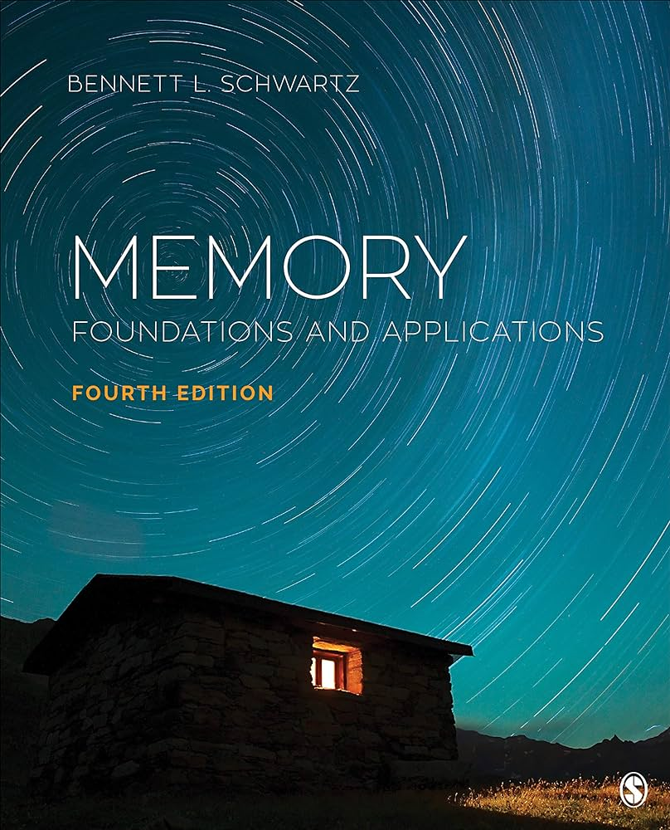
What will I Need?
Textbook: Memory: Foundations and Application by Bennett L. Schwartz (4th Edition) (2020)
Something to take notes with
You!

Slide 6
Grade Breakdown
3 Exams (1oo pts each; 300 pts total) (60%)
Weekly Chapter Quizzes (150 points) (30%)
  Due Fridays at 11:59pm
  Lowest grade dropped
Attendance/Participation (50 points) (10%)

Slide 7
Questions??

Slide 8
Discussion: What is Memory?
What is memory for? What does it do for us?
Notes:
So, if the essential task of a memory system is to carry information forward in time, what properties should that system have? Think about the memory devices you use in everyday life: A USB stick, a post-it note, your mind, etc. What do they need to be able to do?

Slide 9
Discussion: What is Memory?
What kind of memory devices do you use each day?
Notes:
So, if the essential task of a memory system is to carry information forward in time, what properties should that system have? Think about the memory devices you use in everyday life: A USB stick, a post-it note, your mind, etc. What do they need to be able to do?

Slide 10
Types of Memory
Short-Term vs. Long-term
Semantic vs. Episodic
Autobiographical

Slide 11
Short-term Memory
Requires Active Maintenance to prevent forgetting
Example: Remembering digits of a phone number
What else?

Slide 12
Long-term Memory
Many different types
  Implicit vs. Explicit
  Episodic vs. Semantic

Slide 14
Words
Aroma

Slide 15
Words
Scent

Slide 16
Words
Whiff

Slide 17
Words
Nose

Slide 18
Words
Breathe

Slide 19
Words
Perfume

Slide 20
Words
Fragrance

Slide 22
Words
Aroma
Scent
Whiff
Stench
Nose
Breathe
Perfume
Fragrance

Slide 23
Memory Errors
Types of memory problems?
Forgetting
False Memories
Deese-Rodieger-McDermott Illusion (DRM)

Slide 24
Done! Reminders!
Chapter 1 (1/18/24)
Chapter 1 Quiz Due (1/19/24 @ 11:59pm)

